Slide 1
VMT Jenkins User Guide
A step-by-step example of add a regression in Jenkins and then run it

Slide 2
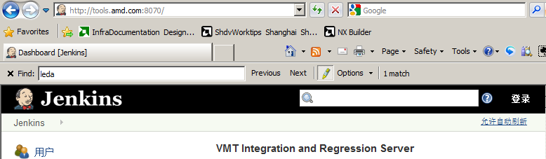
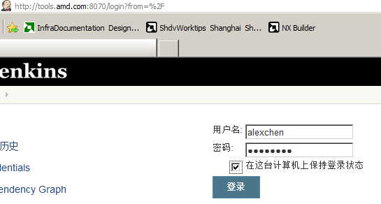
Visit http://tools.amd.com:8070
Login

Slide 3
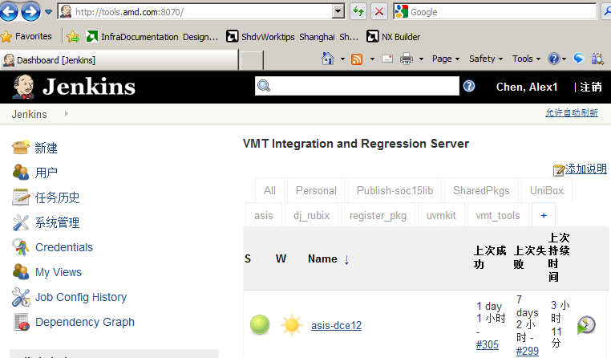
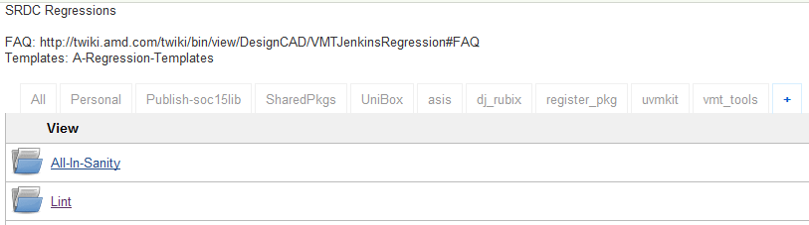
Click UniBox -> Lint

Slide 4
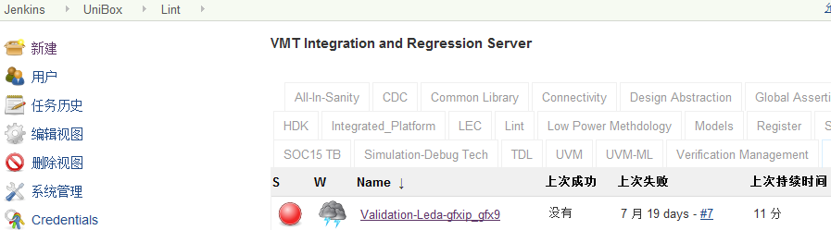
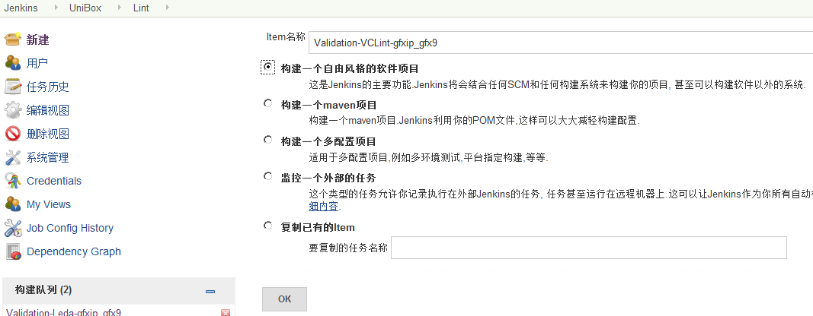
New Project
Input Validation-VCLint-gfxip_gfx9
-- Then OK

Slide 5
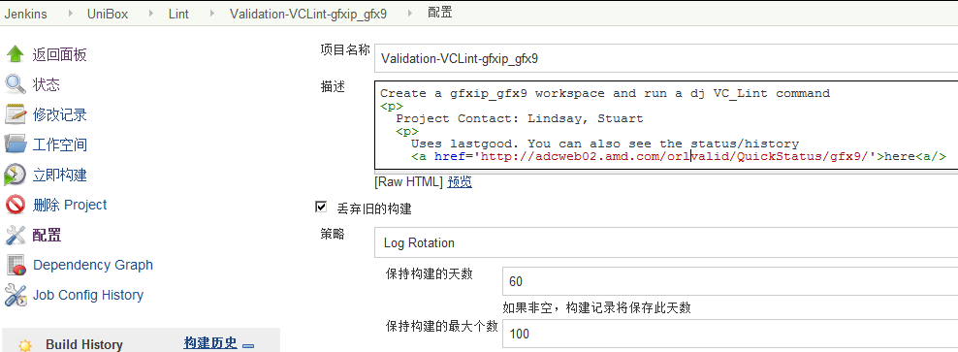
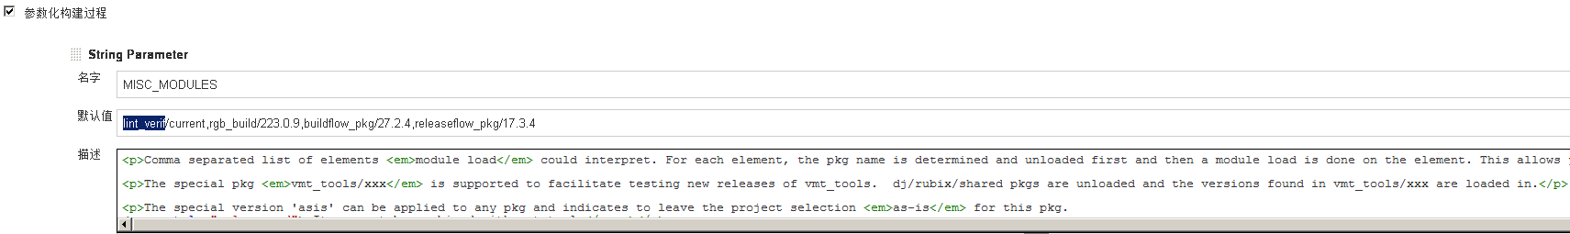
Initial Config Your Project
Description
Project Parameters

Slide 6
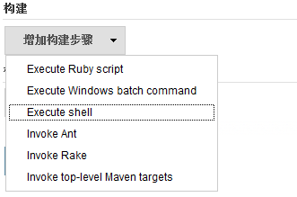
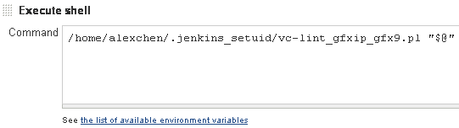
Add Execution Shell

Slide 7
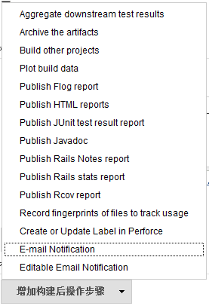
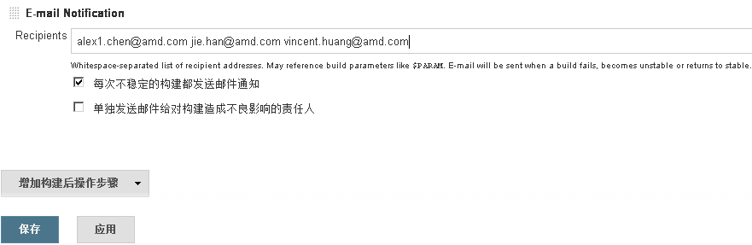
Add Email Notification
And then Save

Slide 8
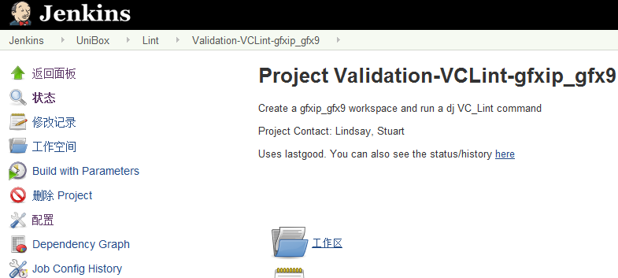
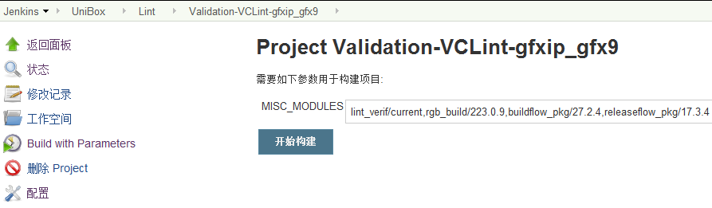
Build/Run Project
Config your run and then Start

Slide 9
Re-Config Your Project
Check Result

Slide 10
Back up

Slide 11
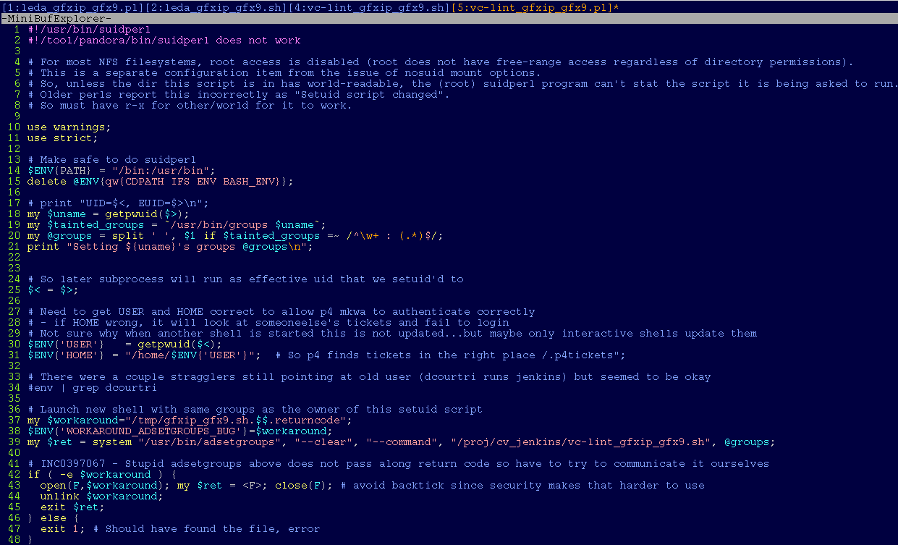
vc-lint_gfxip_gfx9.pl

Slide 12
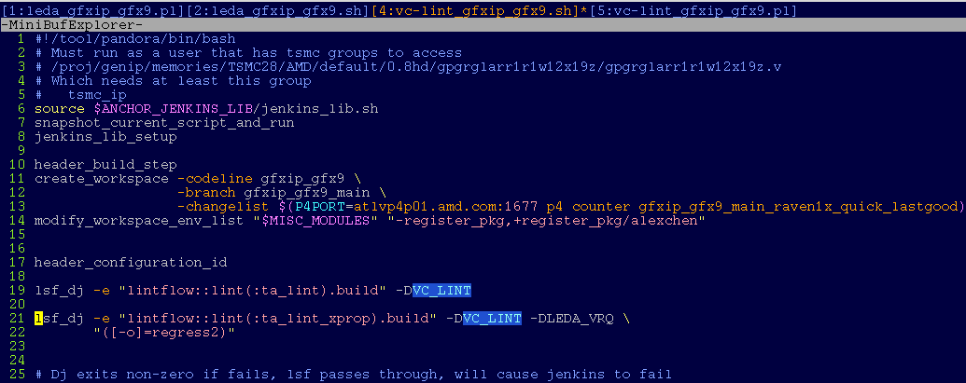
vc-lint_gfxip_gfx9.sh

